Slide 1
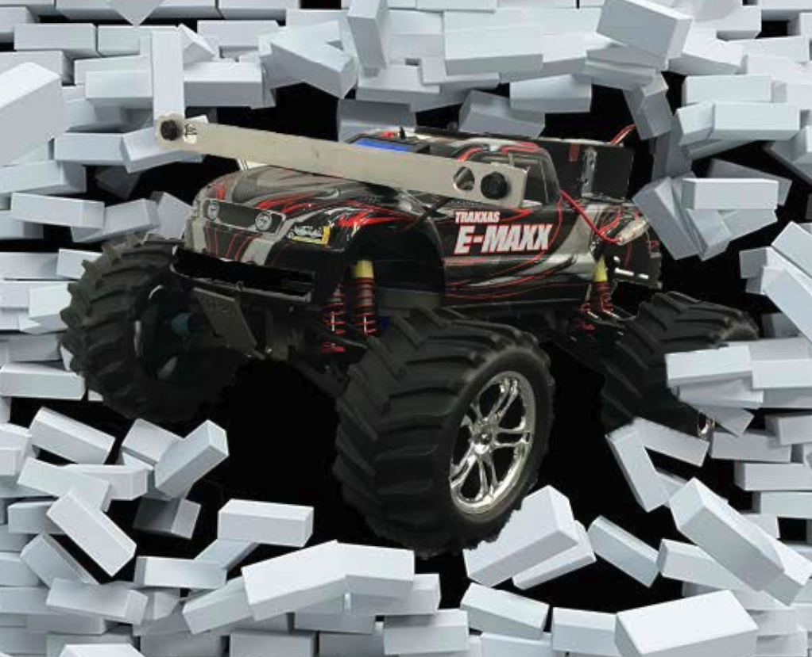
EPO-4
Knight – Rider
Pieter Gommers, Ruben Eland, Arthur Bennebroek, Lennert van Herk, Rick Steman

Slide 2
First GUI
Balletje enzo
Getting to know the environment and adding the basic functions

Slide 3
Car model
Eerste auto model
This is when the midterm was

Slide 4
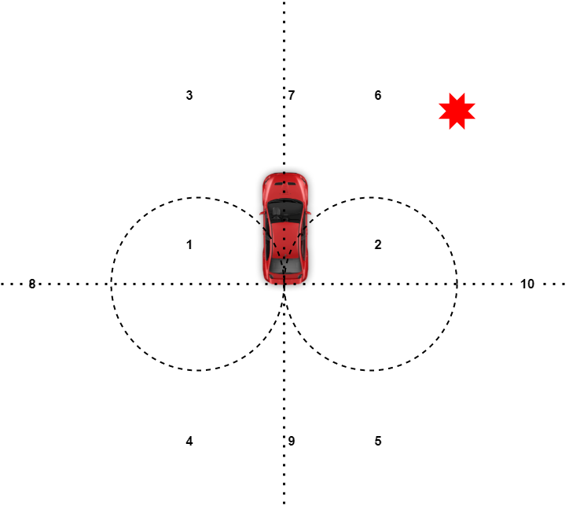
Route Builder
Divided up into 6 segments
Vertel iets over de 6 segmenten en dat in de GIF te zien is (3e van onder) welk segment het waypoint zit

Slide 5
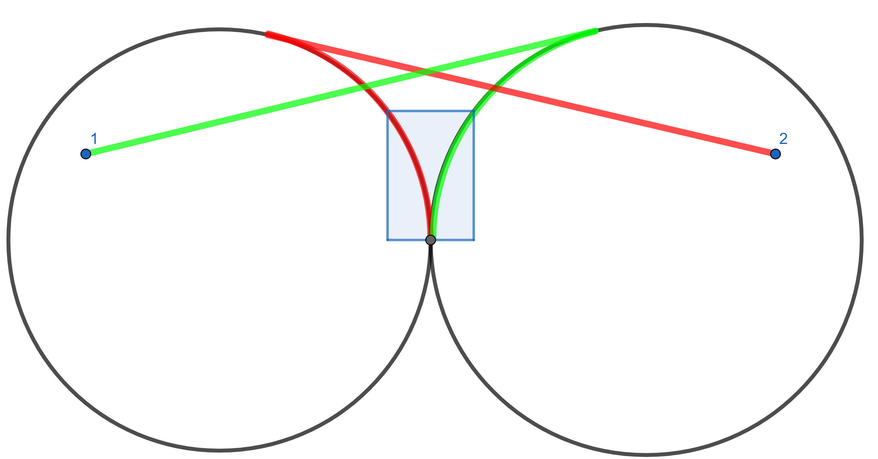
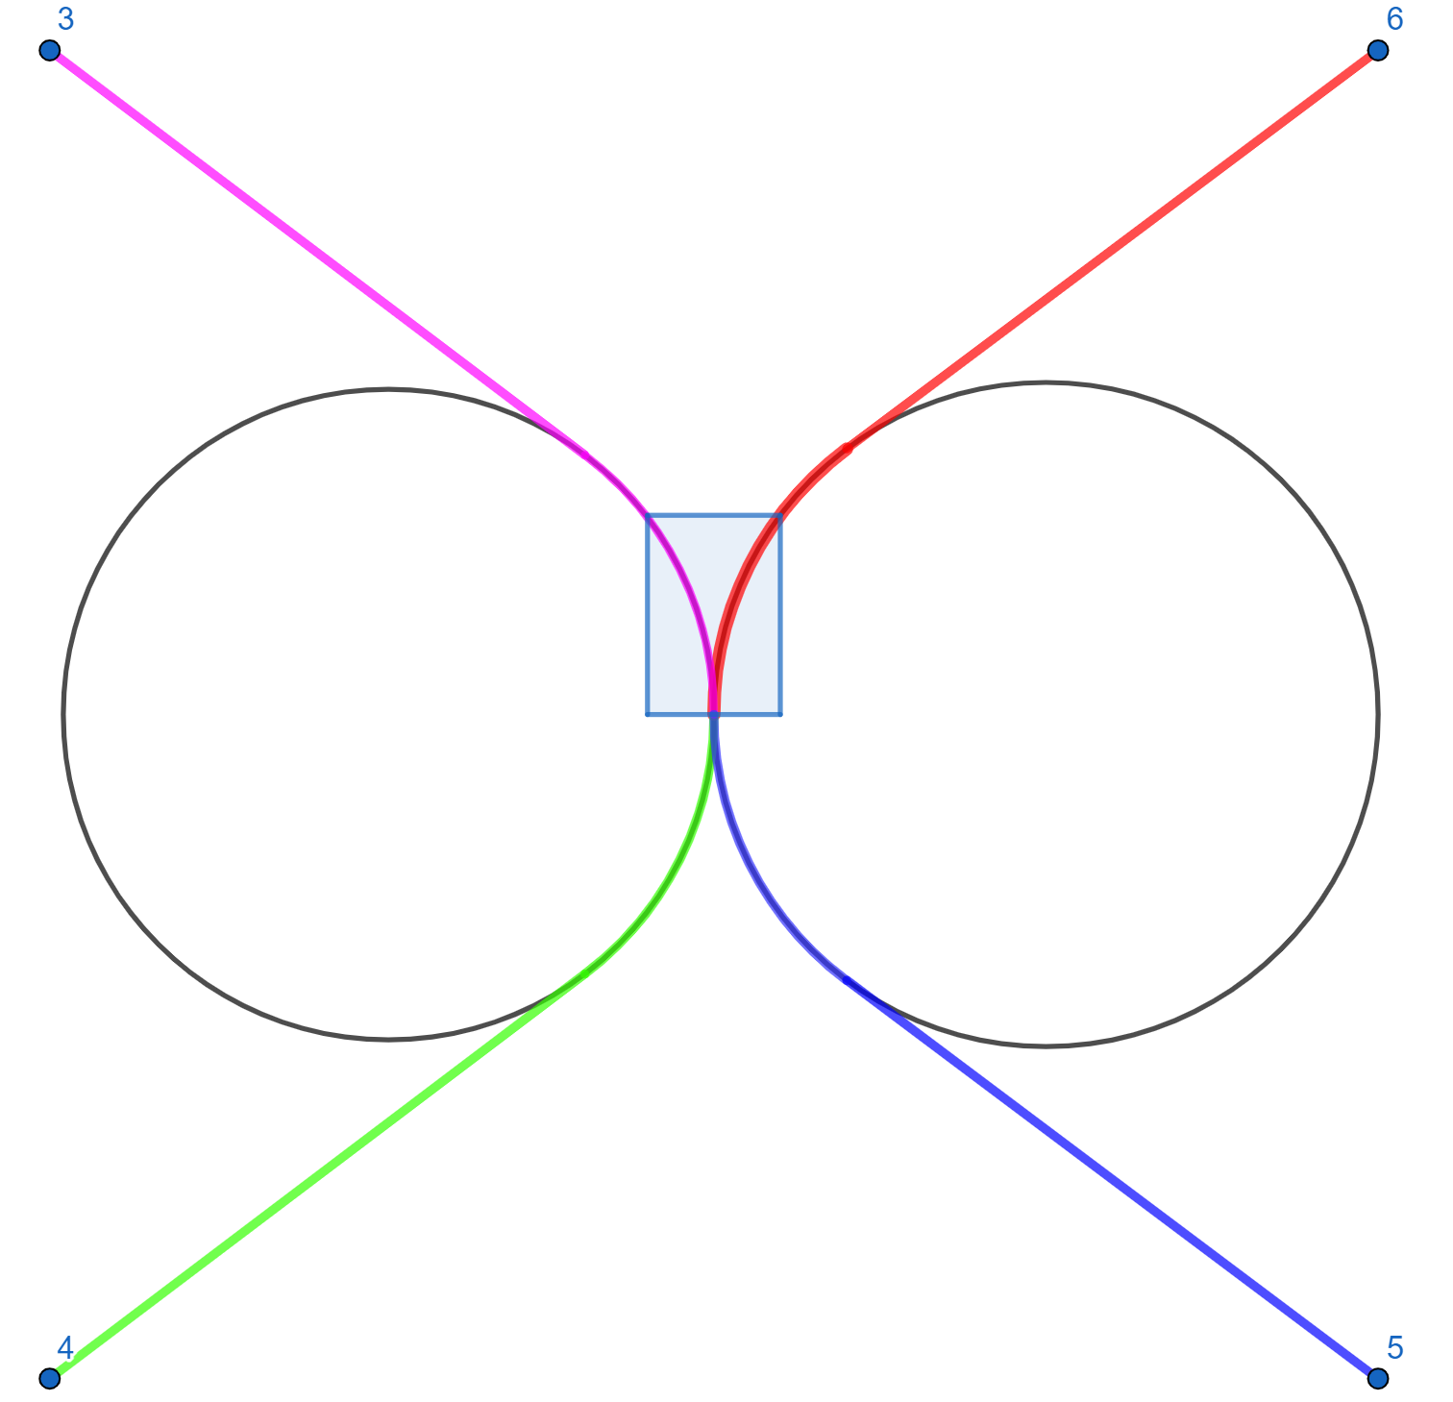
BANG-BANG control
First version where car drove itself
BANG BANG control van module 3 aangepast naar cirkel en rechtdoor, de route per segment is aangegeven in het plaatje

Slide 6
TDOA estimation
TDOA was added, which was not perfectly accurate thus:
Added function to discard terrible outliers of TDOA
Ignore TDOA during initial turning since turning radius and direction are known
Added feedback on straight line to redirect the car to the waypoint of it goes off its trajectory

Slide 7
Final challenge
Dissapointing performance due to outliers of TDOA resulting in a too large deviation from end point causing deduction
Challenge C not completed due to time constraints
Received bonus points for ability to drive backwards and reach waypoints close to car (inside turning radius)

